Slide 1
Multi chain effect analysis from paired antibody repertoire data
Student: Sedreh Nassirnia
Superviser: Maria Chernigovskaya

Slide 2
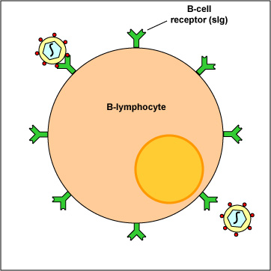
B cells and antibodies
B cell receptor
(BCR)
B cell — circulating lymphocyte in the blood
B cells are secreting antibodies
Antibody can bind to the antigen and elicit immune responses to destroy the pathogen
Antibody repertoire = set of produced antibodies
B cell
antibodies
antigen
Notes:
a set of circulating antibodies
Antibody drug development based on reconstruction of antibody repertoire
investigating antibody repertoire based on immunosequencing reads
Decompose reads according to their V, D, and J segments, and provides basic information about the diversity of a repertoire by V(D)J classification

Slide 3
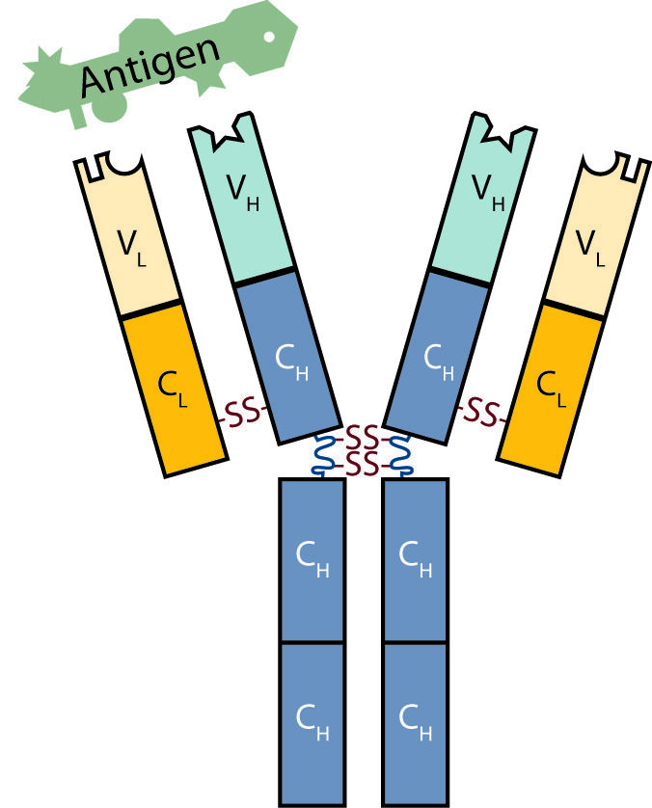
BCR structure
BCR is made up of two kinds of proteins
The heavy chain (Hc)
IGH
The light chain (Lc)
IGK
IGL
The unique combination of heavy and light chain defines BCR specificity
Light chain
Heavy chain
Notes:
The gene segments that will be chosen to make
up the final Hc gene are located on chromosome 14, and
each B cell has two chromosome 14s (one from Mom and
one from Dad). This raises a bit of a problem, because,
as we discussed earlier, each B cell makes only one kind
of antibody. Therefore, because there are two sets of
Hc segments, it is necessary to “silence” the segments on
one chromosome 14 to keep a B cell from making two dif-
ferent Hc proteins

Slide 4
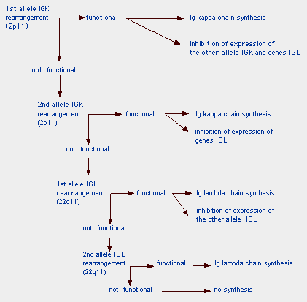
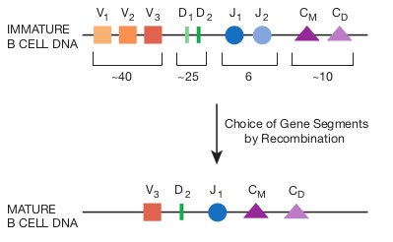
VDJ-recombination + allelic exclusion
Allelic exclusion ensures that only one heavy and one light chain specificity are produced by a B cell
Notes:
In B lymphocytes, successful heavy chain gene rearrangement of the genetic material from one chromosome results in the shutting down of rearrangement of genetic material from the second chromosome. If no successful rearrangement occurs, rearrangement of genetic material on the second chromosome takes place. If no successful rearrangement occurs on either chromosome, the cell dies. A B-cell synthesizes a single type of heavy chain and light chain, even though its genome has 2 chromosomes (2 alleles) for each Ig locus; allele exclusion must therefore occur

Slide 5
Allelic inclusion
Sometimes B-cell can produce two productive light chains (mostly IGK+IGK)
Year | Title | Organism | % of B cells with allelic inclusion
2015 | Immunoglobulin light chain allelic inclusion in systemic lupus erythematosus | Human | 0.2 — 2%
2014 | Dual immunoglobulin light chain B cells: Trojan horses of Autoimmunity? | Mouse | 2 — 10%
2008 | Allelic and Isotypic Light Chain Inclusion in Peripheral B Cells from Anti-DNA Antibody Transgenic C57BL/6 and BALB/c Mice | Mouse | 12%
2007 | Igκ allelic inclusion is a consequence of receptor editing | Mouse, Human | 10%
2006 | Dual Surface Immunoglobulin Light-Chain Expression in B-Cell Lymphoproliferative Disorders | Mouse | 1.5%
Notes:
a single peripheral B cell expresses H and L chains encoded by only one of their IgH and IgL chain alleles, respectively, resulting in BcRs with one antigen-binding VH/VL combination on their cell surface

Slide 6



Standard rep-seq data
Common process: RNA ➝ cDNA ➝ PCR
Pros:
Measure antibody frequencies with up to 99% frequency
Cons:
Challenging data analysis
Lose information about heavy and light chains pairing
Can’t use this data to study multi chain effect!
rep-seq

Slide 7

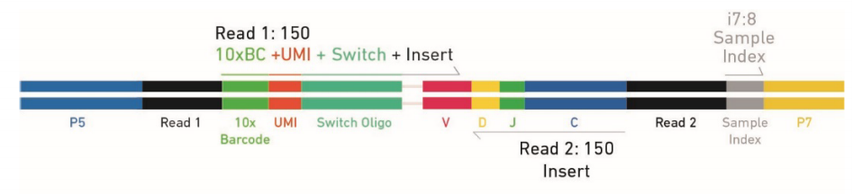
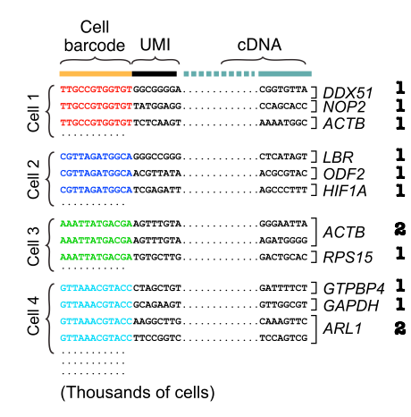
Single Cell RNA-seq (paired) data
Each read has cell barcode and UMI (molecular barcode)
Pros:
We know all chains for each cells
Cons:
Unstable protocols and trash data
Barcodes collisions
(two different cells have the same barcode)
IGH
IGK
IGL
IGH
IGK
IGK

Slide 8
Goal of the project
Given an antibody repertoire (single cell sequencing data) we want to:
Estimate the number of cells with multi chain effect
Distinguish the multi chain effect from barcodes collision and PCR errors
We will use 10x-VDJ public datasets
IGH
IGK
IGL
IGH
IGK
IGK
IGH
IGL

Slide 9
Public 10x-VDJ datasets
Mouse datasets (published on November 2018)
PBMCs (~4.975 expected Ig-expressing cells recovered) — targeted enrichment of B cell Igs from Peripheral Blood Mononuclear Cells pooled from BALB/c mice
Splenocytes (~4.300 expected cells recovered) — B cells isolated from C57BL/6 mouse splenocytes - Direct Ig enrichment
Human datasets (published on August 2018)
To be done later (3 datasets)

Slide 10
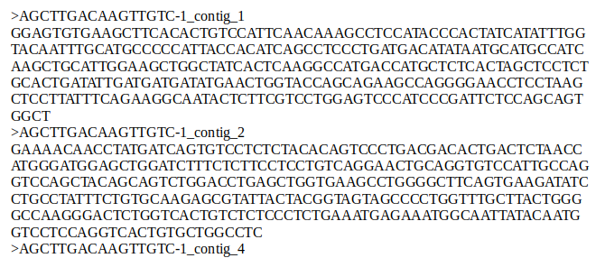
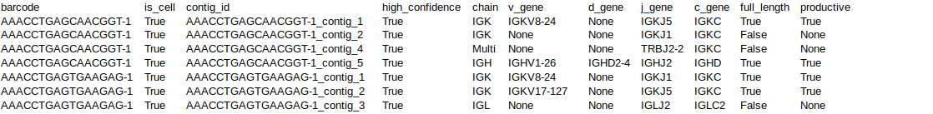
Public 10x-VDJ datasets structure
cell barcode
Fasta file
Annotation file
chain
contig id (UMI)
IGH/K/L
V
D
J
chain

Slide 11
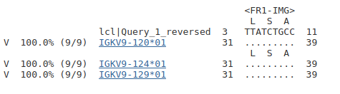
10x-VDJ data is suspicious: example
According to 10x annotation some chains don’t have V, D or J genes
That doesn’t sound truly!
V
D
J
If we reannotate this chain with IgBlast (state of the art tool for BCR annotation) we observe that only 9 nucleotides were aligned to Ig genes.
It looks like 10x annotation and filtration doesn’t work well!
IgBlast output

Slide 12
10x annotation is inaccurate
dataset |  | 10x annotation | IgBlast
PBMCs | #cells | 4424 | 4234
 | #chains | 16036 | 10517
Splenocytes | #cells | 4852 | 4419
 | #chains | 17598 | 9519
Table1: Comparison of number of cells and chains

Slide 13
10x annotation is inaccurate
We compared 10x annotation with IgBlast annotation (state of the art annotator)
 | 1 chain | 2 chains | 3 chains | 4 chains | 5 chains | 6 chains | > 6 chains
PBMCs
10x annotation | 0.7% | 14.58% | 33.43% | 31.62% | 14.22% | 3.98% | 1.46%
IgBlast | 9.57% | 73.13% | 10.36% | 4.89% | 1.31% | 0.41% | 0.51%
Splenocytes
10x annotation | 1.58% | 15.83% | 31.45% | 30.26% | 13.66% | 4.53% | 2.39%%
IgBlast | 5.72% | 78.19% | 11.97% | 3.44% | 0.52% | 0.11% | 0.05%
Table2: B cells distribution by number of chains in a cell

Slide 14
10x annotation is inaccurate
We compared 10x annotation with IgBlast annotation (state of the art annotator)
Table3: B cells distribution by chain type
10x annotation
 | 1IGH | 1IGK | 1IGL | 1IGH_1IGK | 1IGH_1IGL | 1IGH_2IGK | 1IGH_1IGK_1IGL | Other
PBMC | 0.07% | 1.20% | 0.05% | 32.62% | 17.76% | 2.60% | 12.51% | 33.19%
Splenocytes | 0.14% | 2.58% | 0.29% | 20.97% | 2.54% | 6.58% | 38.05% | 28.98%
IgBlast
 | 1IGH | 1IGK | 1IGL | 1IGH_1IGK | 1IGH_1IGL | 1IGH_2IGK | 1IGH_1IGK_1IGL | Other
PBMC | 0.66% | 9.39% | 0.41% | 71.92% | 1.88% | 6.58% | 7.62% | 1.54%
Splenocytes | 0.68% | 4.73% | 0.32% | 72.58% | 3.19% | 4.98% | 7.38% | 6.15%

Slide 15
Multi chain or an artifact?
9% in PBMCs dataset
11% in splenocytes dataset
2 — 10% in the papers
We should distinguish the multi-chain effect from
PCR error
Barcodes collision

Slide 16
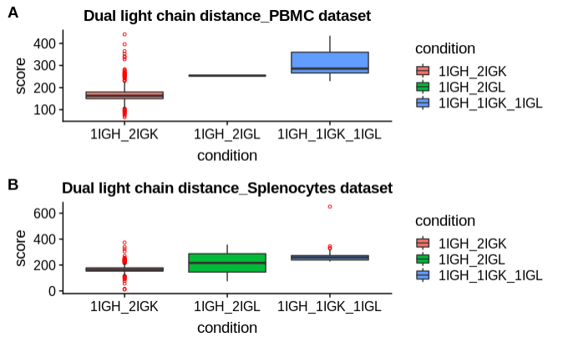
Multi chain or PCR error?

Slide 17
Current results
Literature review was made
We found that 10x genomics annotation is inaccurate and we should reannotate data using IgBlast
Mouse datasets were processed
B cells with dual productive light chains were found
Distances between dual light chains were calculated to make sure that this is not a PCR errors
https://github.com/Sedreh/BCRs-analysis

Slide 18
Future plans
Process human datasets
Try to distinguish multi chain effect from barcodes collision
* Find some interesting recombination events in the filtered data

Slide 19


